Slide 1
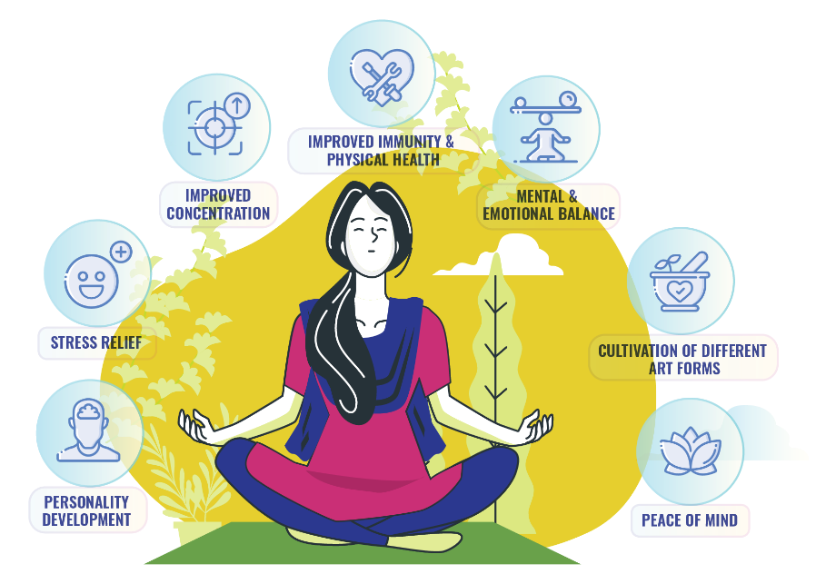

SAHAJA YOGA
Meditation

Slide 2
Overview
What is Sahaja Yoga?
Prepare & Experience
Simple meditation - balancing
Tips for regular meditation
2
3
4

Slide 3
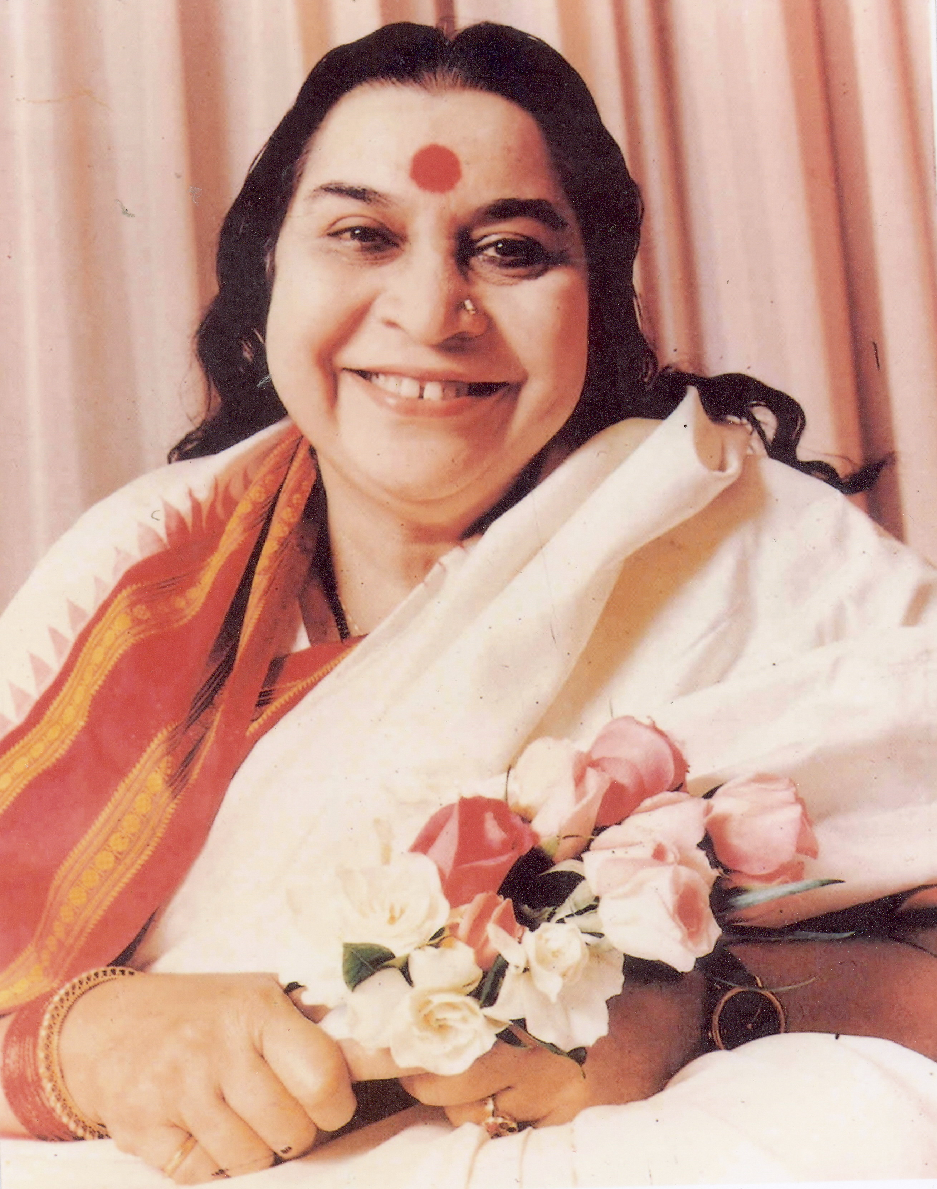
What is Sahaja Yoga?
Sahaja Yoga begins with an experience of effortless and spontaneous awakening of your inner energy called kundalini.
This process of kundalini awakening is known as self-realization, the highest state human beings can achieve.
Sahaja means “born with you”; Yoga is “union”with the Divine
The awakened Kundalini connects our spirit with the all-pervading Divine cosmic energy.
With yoga, one achieves thoughtless awareness, inner peace, balance and a state of bliss.
“The thought rises, falls, another thought rises and falls, and we are jumping on the cusp of future and past. We cannot be in the present, which is the reality. Present is the reality.”
- Shri Mataji Nirmala Devi

Slide 4
Subtle system – Chakras & Channels

Slide 5
Sahajayoga - Health benefits
Scientific research shows Sahajayoga can help improve a variety of health conditions including
Attention-Deficit/Hyperactivity Disorder (ADHD)
Anxiety
High blood pressure
Stress
Depression
Menopause
Asthma
Epilepsy
2
Notes:
SYM has been shown to improve a variety of health conditions including (make it two slides)
anxiety2, high blood pressure2, : Meditation treatment was associated with significant improvements in quality of life, anxiety reduction, and blood pressure control.
stress5,: Sahaja Yoga meditation, is a safe and effective strategy for dealing with work stress and depressive feelings. The findings suggest that “thought reduction” or “mental silence” may have specific effects relevant to work stress and hence occupational health.
depression6,: participants in the Sahaja Yoga group reported significant reductions on all measures of symptomology, (for the symptoms of anxiety and depression)
Attention-Deficit/Hyperactivity Disorder7,: SYM may offer families an effective management tool for family-oriented treatment of childhood ADHD.
menopause8,: menopausal symptoms, especially vasomotor (causing or relating to the constriction or dilatation of blood vessels.; denoting a region in the medulla of the brain (the vasomotor center ) – medulla carries nerve signals and controls heartbeat, breathing, blood pressure etc.) symptoms, and particularly hot flashes, might be substantially improved by using meditation
asthma9: Sahaja yoga does have limited beneficial effects on some objective and subjective measures of the impact of asthma
epilepsy10-12. : reduction in stress in patients of epilepsy following Sahaja yoga practice may be responsible for clinical improvement which had been earlier reported in patients who practised Sahaja yoga.

Slide 6
Our inspiration – Shri Mataji Nirmala Devi
1970 – Developed the Sahaja Yoga technique and established the Sahaja Yoga Meditation Worldwide Movement in close to 200 countries. Sahajayoga is always “free”.
1989 – Awarded the UN Peace Medal
1994 & 1996 – Nominated for Nobel Peace prize.
Honored by the Congress and the governments and institutions from many countries.
Shri Mataji Talk

Slide 7
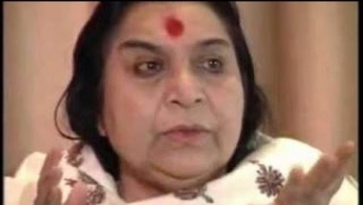
Talk by Shri Mataji

Slide 8
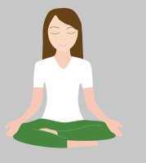
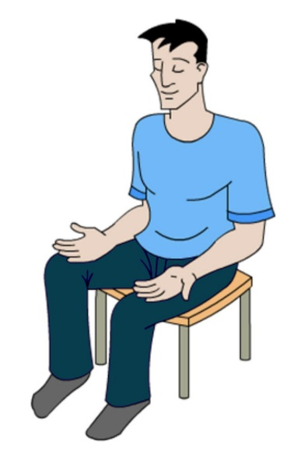
Prepare to experience
Wear comfortable clothes; You may want to remove anything that applies pressure to your body such as belts, eye-glasses etc.
Remove your footwear also if possible.
Choose a clean, neat and preferably a fixed location at home or outside for everyday meditation. You may want to avoid using bathroom for meditation.
You may light a candle to help clean the energy of the environment.
Sit comfortably either on the floor or on a chair with both hands open on lap, palms up.

Slide 9
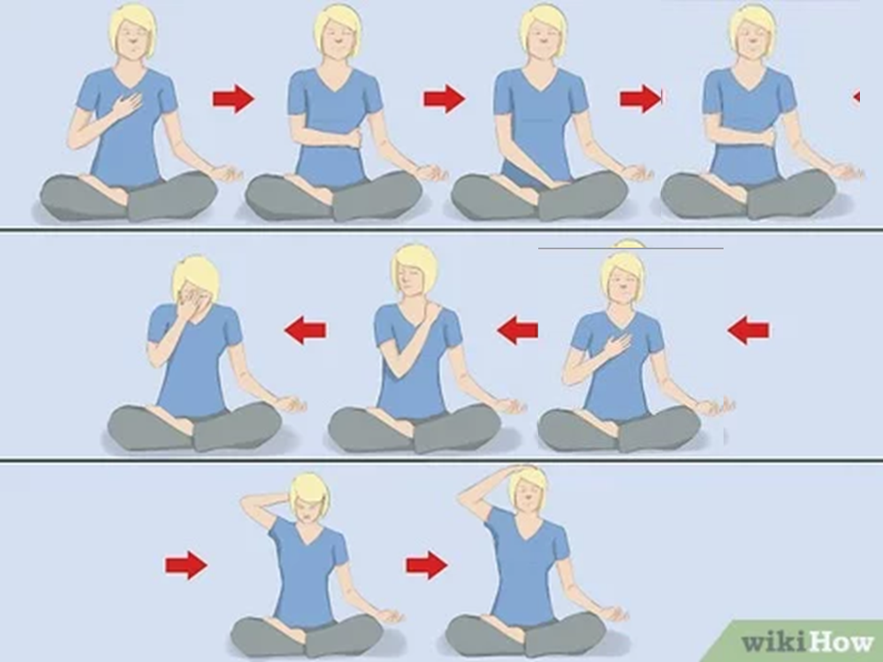
Self-realization steps - Introduction

Slide 10
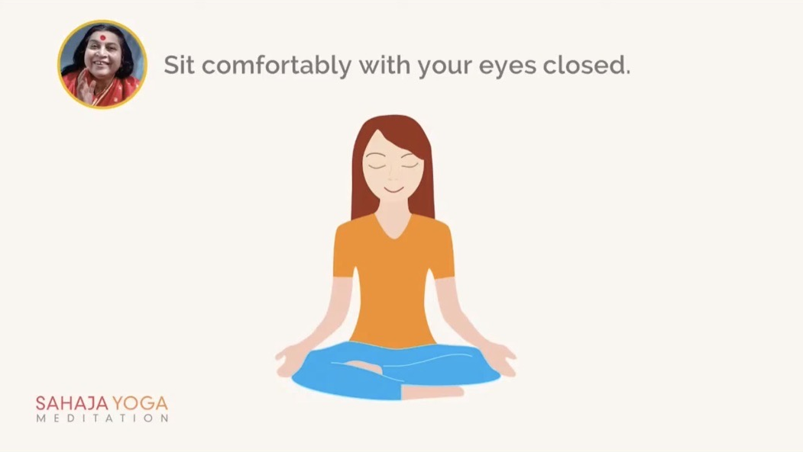
Self-realization experience

Slide 11
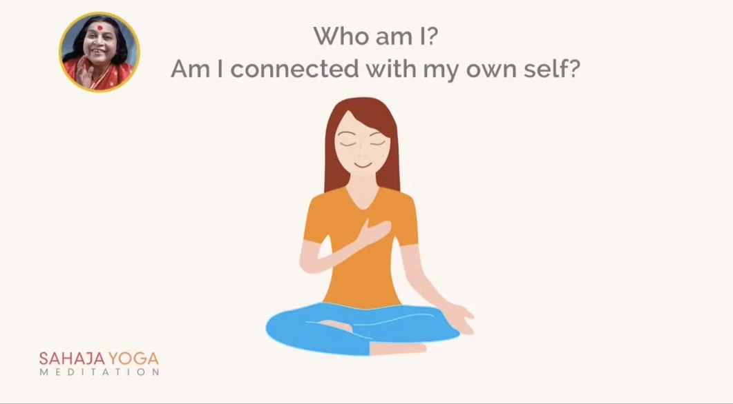
Self-realization experience

Slide 12
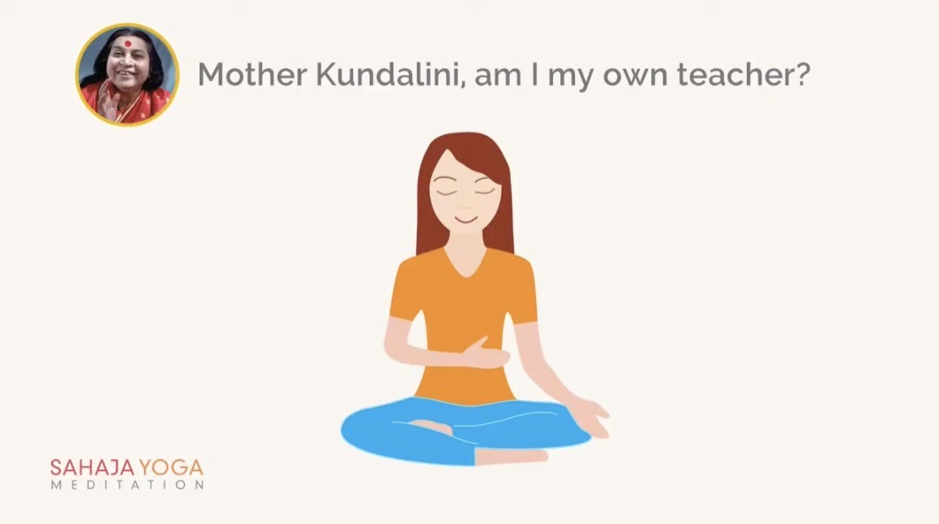
Self-realization experience

Slide 13
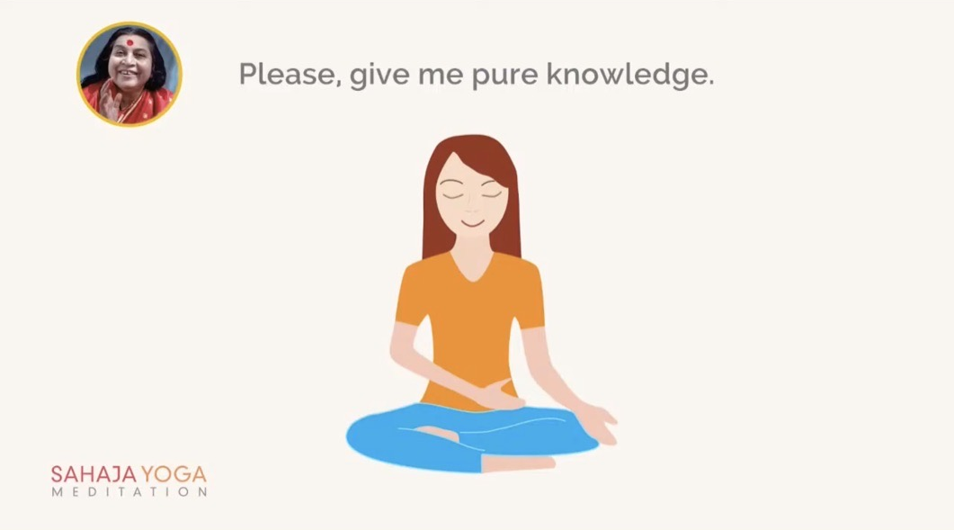
Self-realization experience

Slide 14

Self-realization experience

Slide 15

Self-realization experience

Slide 16
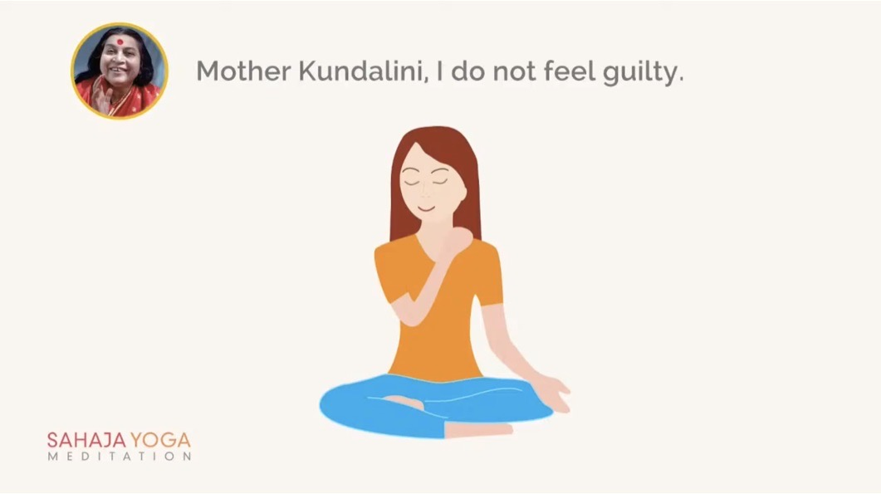
Self-realization experience

Slide 17
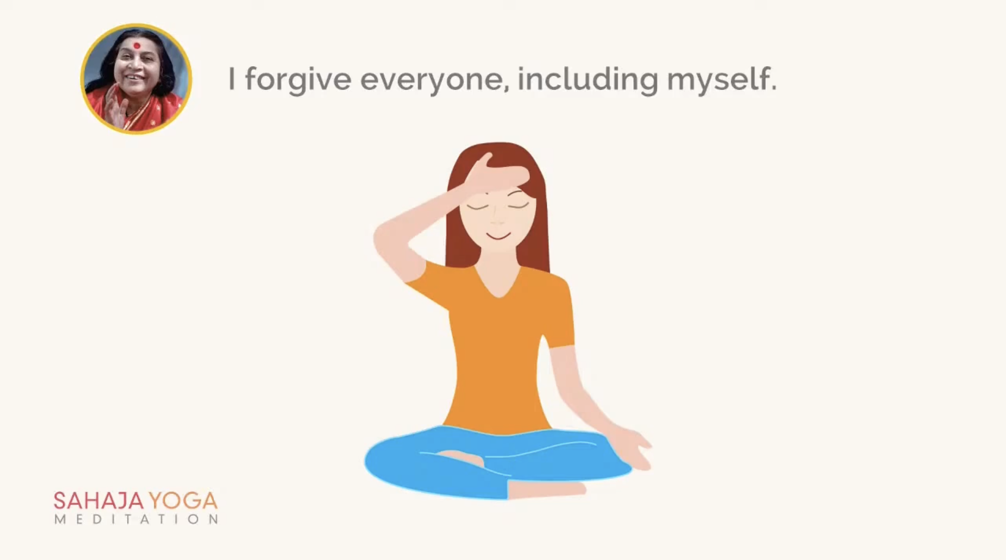
Self-realization experience

Slide 18
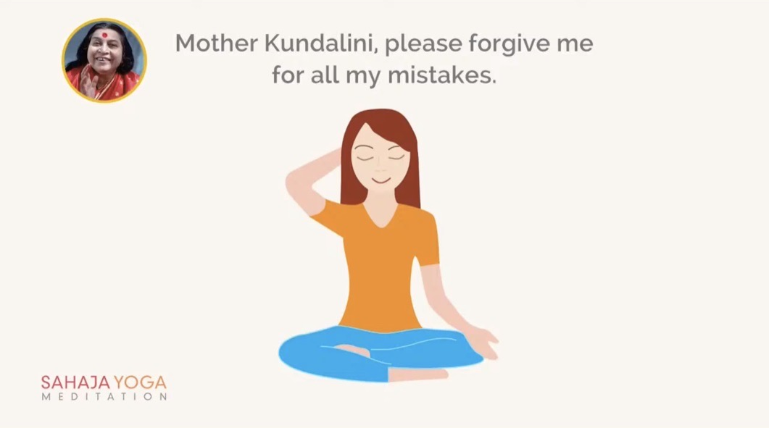
Self-realization experience

Slide 19
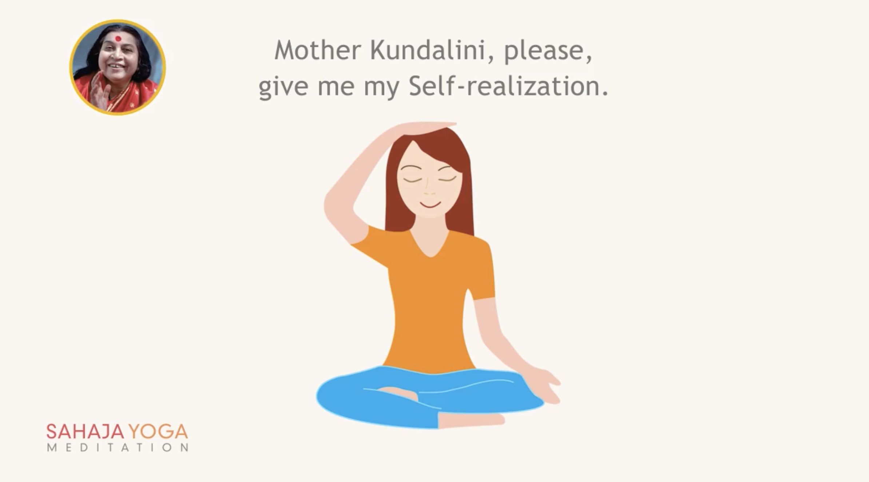
Self-realization experience

Slide 20
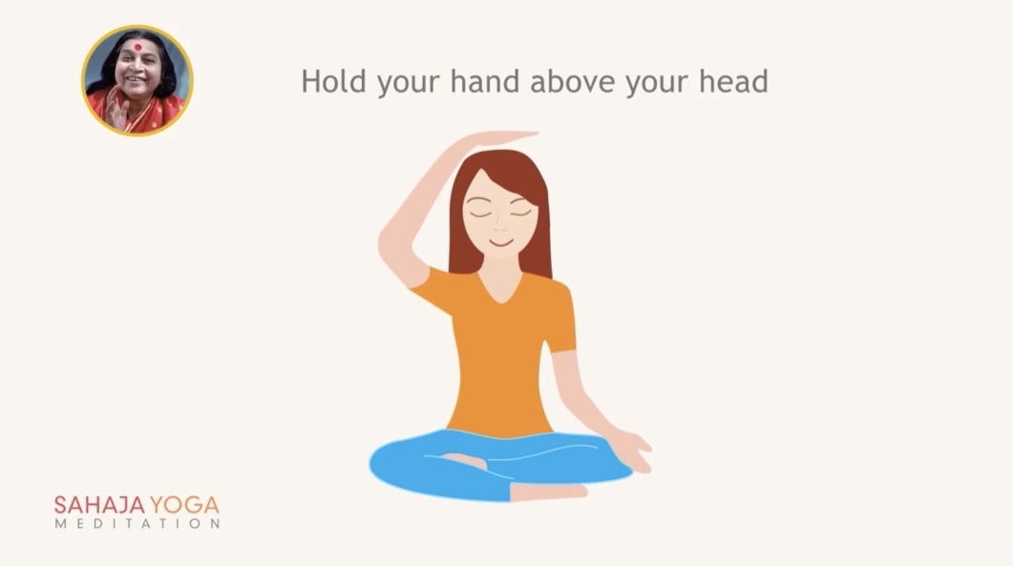
Self-realization experience

Slide 21
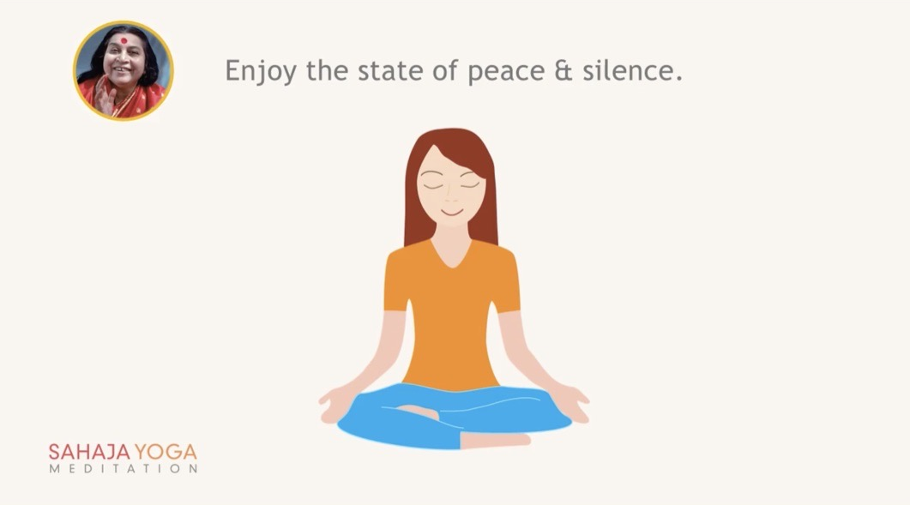
Self-realization experience

Slide 22
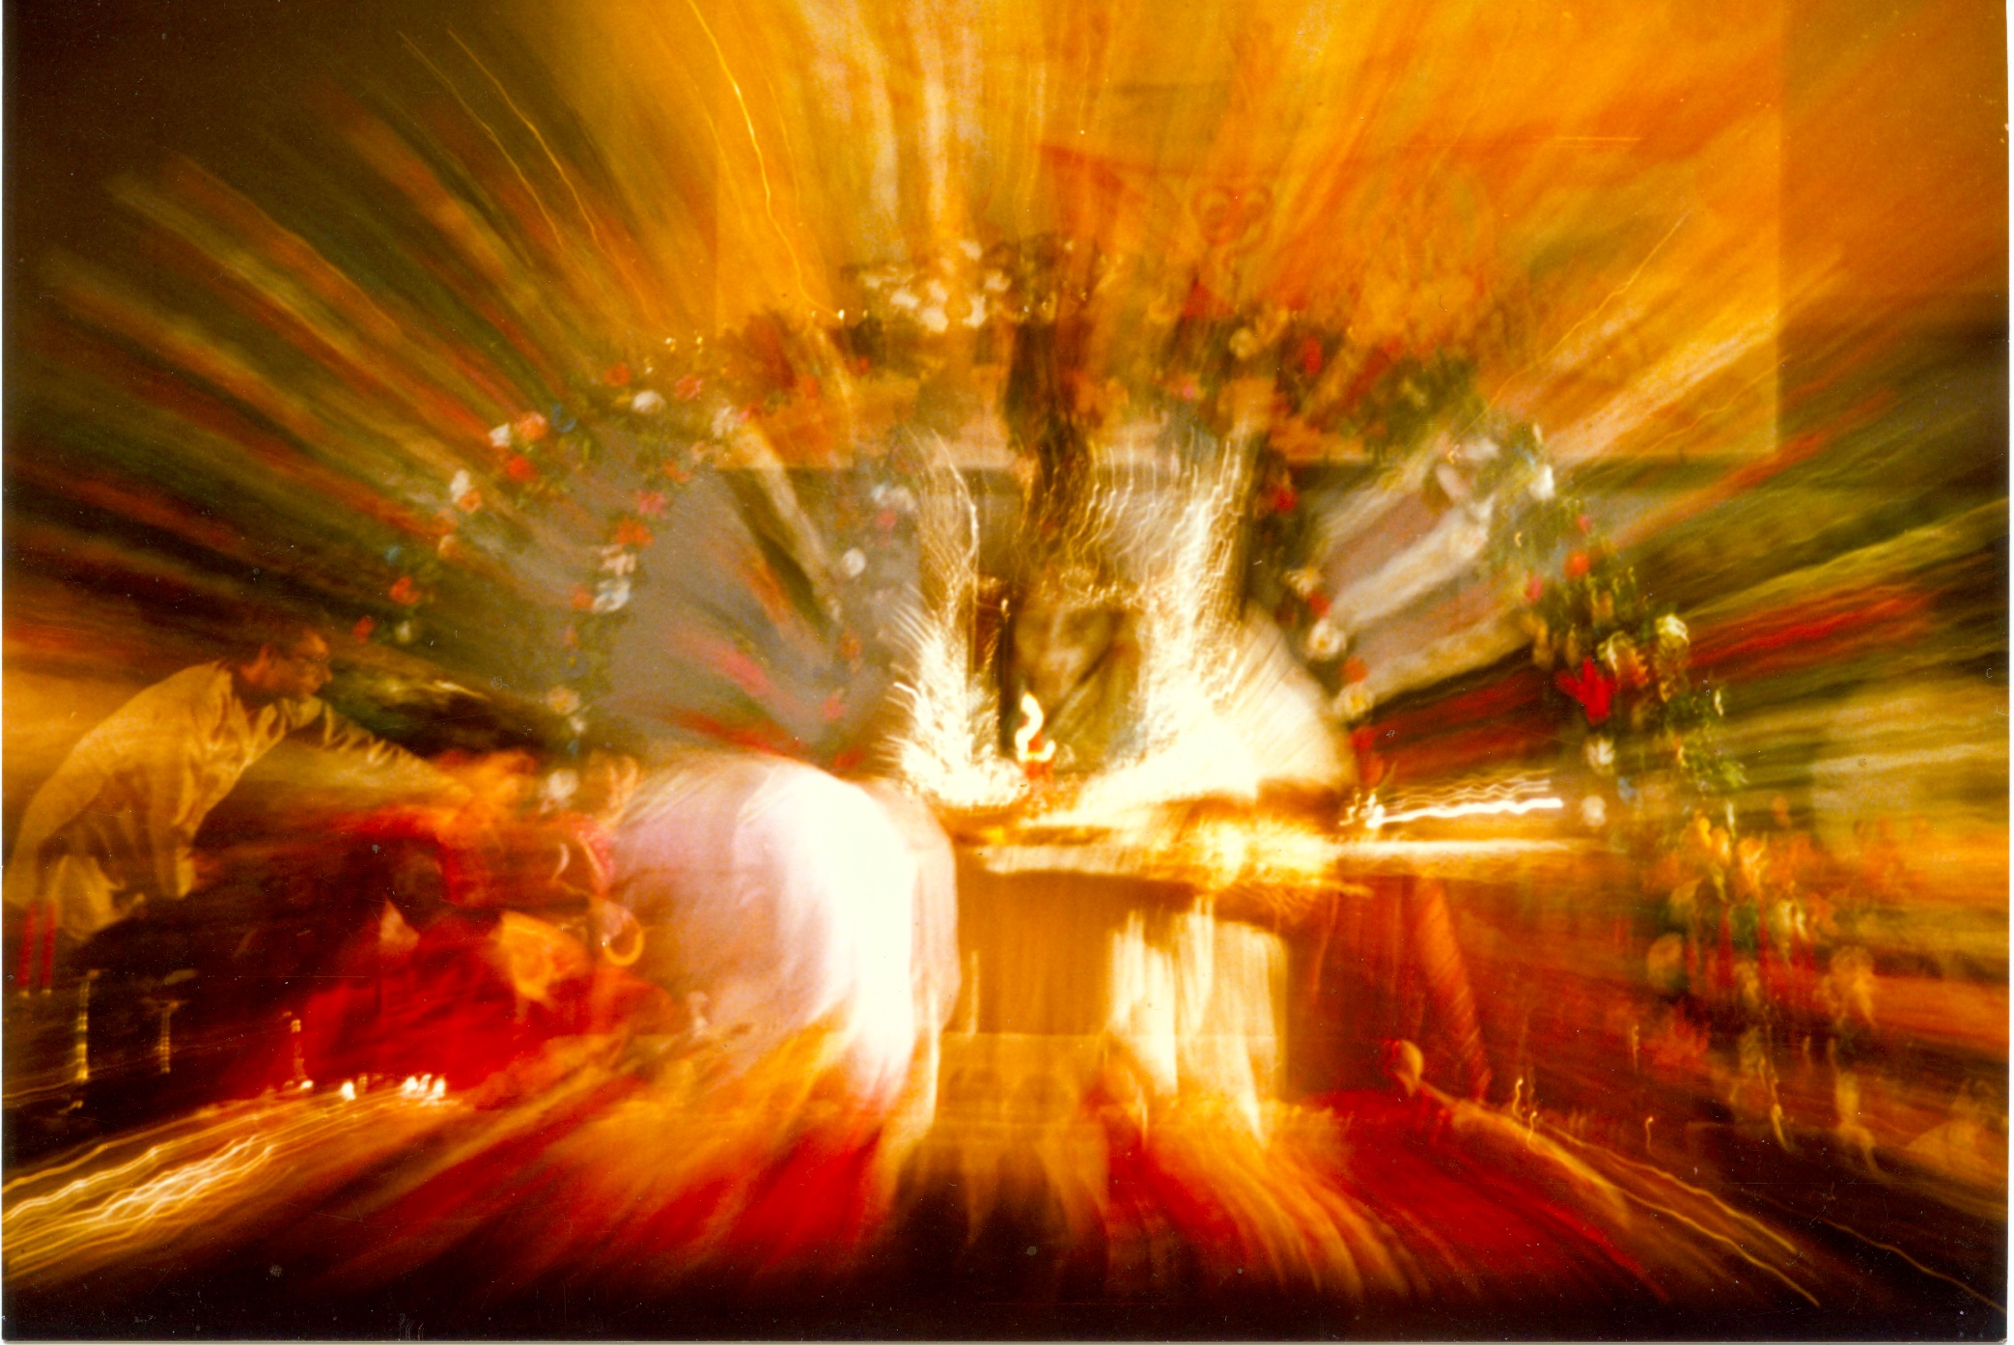
Silent meditation

Slide 23
Subtle system - energy centers and channels

Slide 24
Simple meditation - balancing
Mother, please balance my left channel
Mother, please balance my right channel
Mother, please keep me in the present

Slide 25
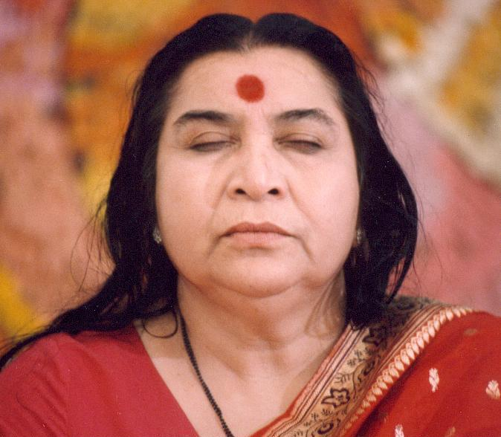
Silent meditation

Slide 26

Tips for regular meditation and free classes
Daily morning and evening 5 -10 minute simple three step meditation
Regular meditation will develop self (vibratory) awareness to diagnose imbalances within one self.
Attending weekly collective meditation at nearest in-person gathering if possible or on-line meditation classes
Free in-person and online SY classes in Atlanta:
https://www.meetup.com/free-meditation-atlanta/
https://freemeditation.com/
https://us.sahajayoga.org/

